Slide 1
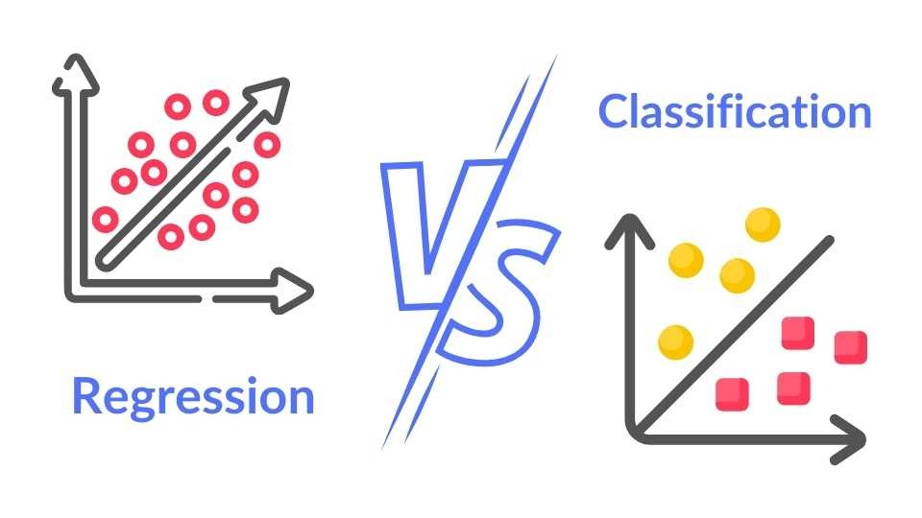
Name : Rehana Amrin
Course: Data Analytics & Data Science

Slide 2

Project workflow
Introduction
Data Collection and Processing
Encoding the categorical data
Model Training
Visualisation
Comparison
conclusion

Slide 3
Introduction
Regression and Classification algorithms are Supervised Learning algorithms.
Both the algorithms are used for prediction in Machine learning and work with the labeled datasets.
Regression algorithms are used to predict the continuous values such as price, salary, age, etc.
Classification algorithms are used to predict/Classify the discrete values such as Male or Female, True or False, Spam or Not Spam, etc.

Slide 4
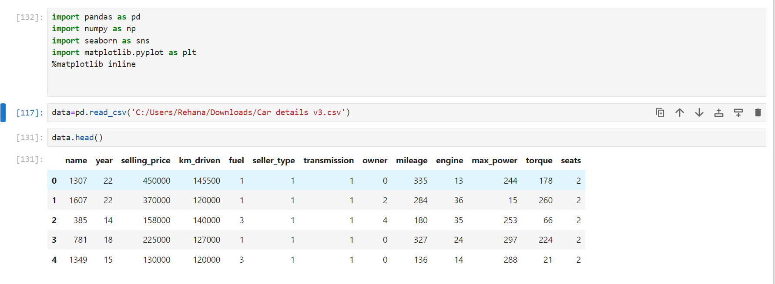
Data collection and processing

Slide 5
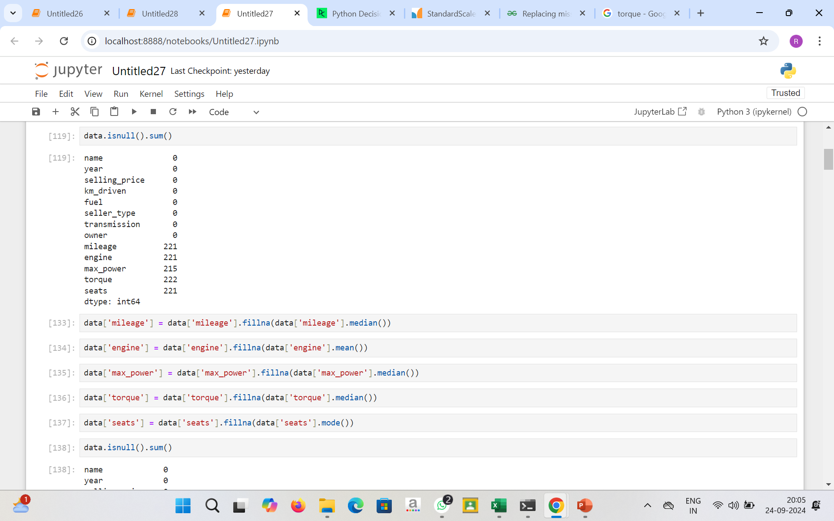
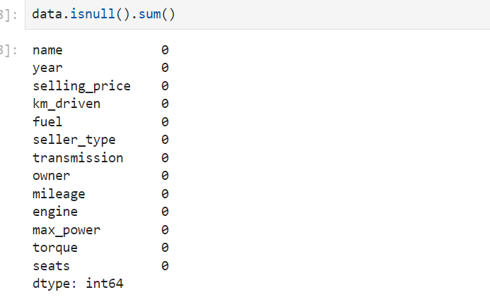
Outlier detection and removal

Slide 6
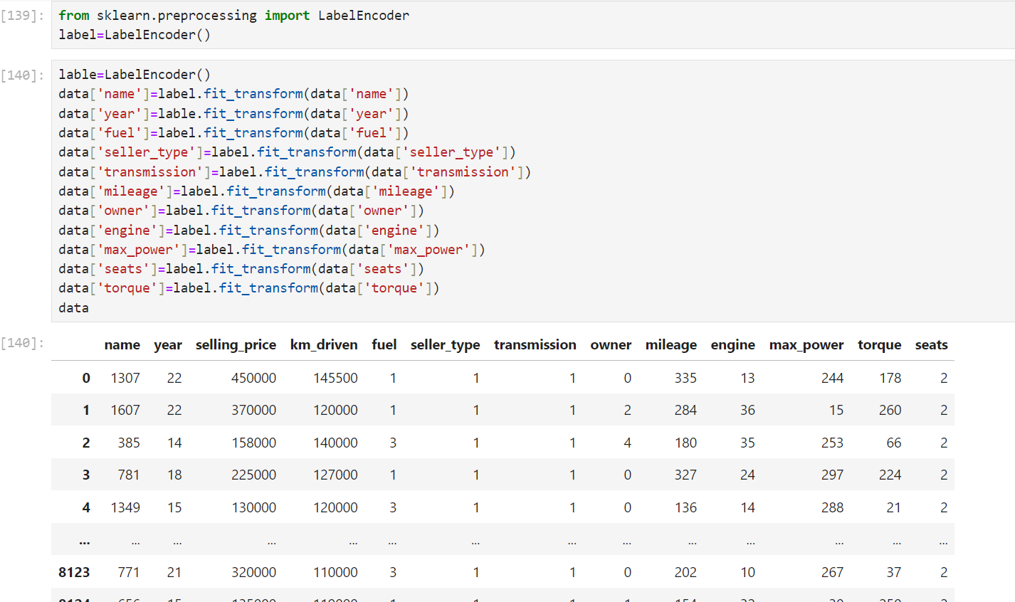

Slide 7
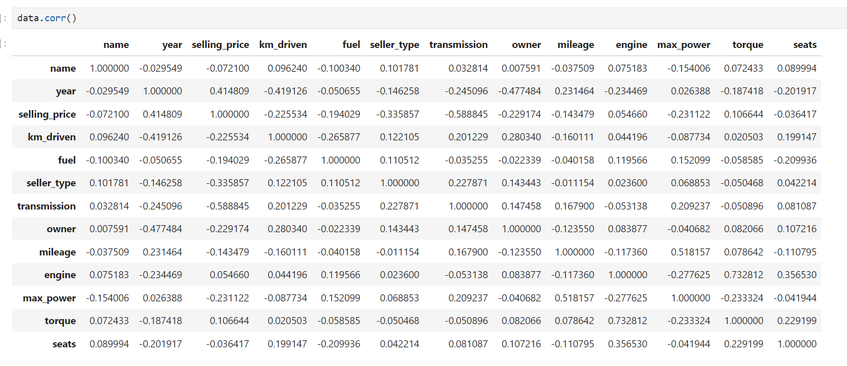

Slide 8
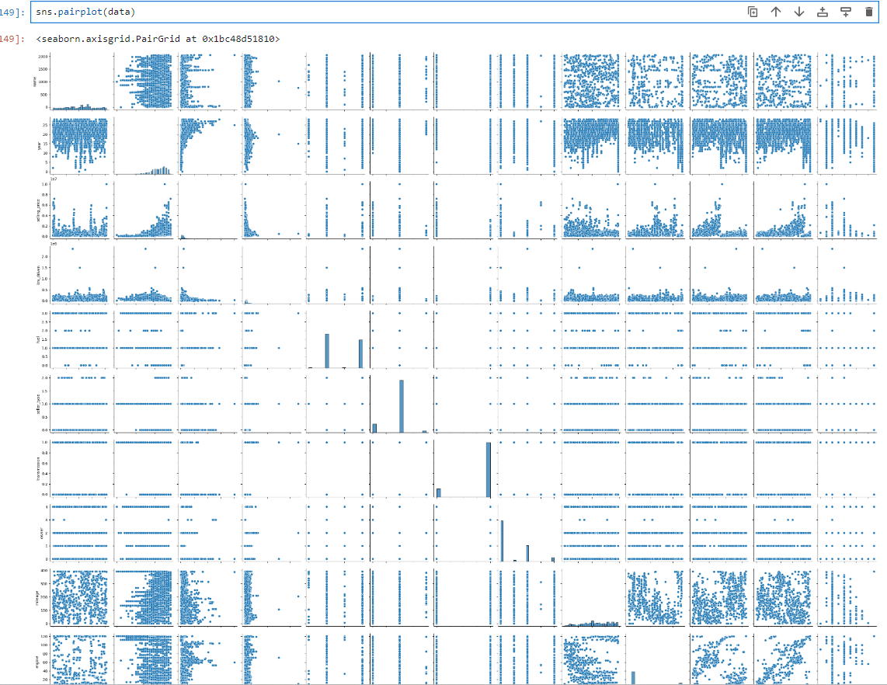
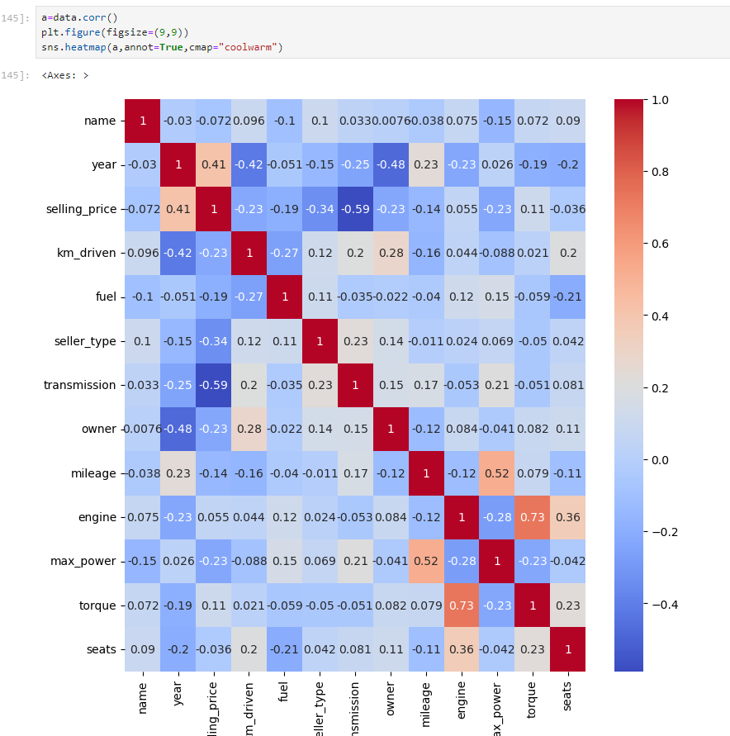

Slide 9
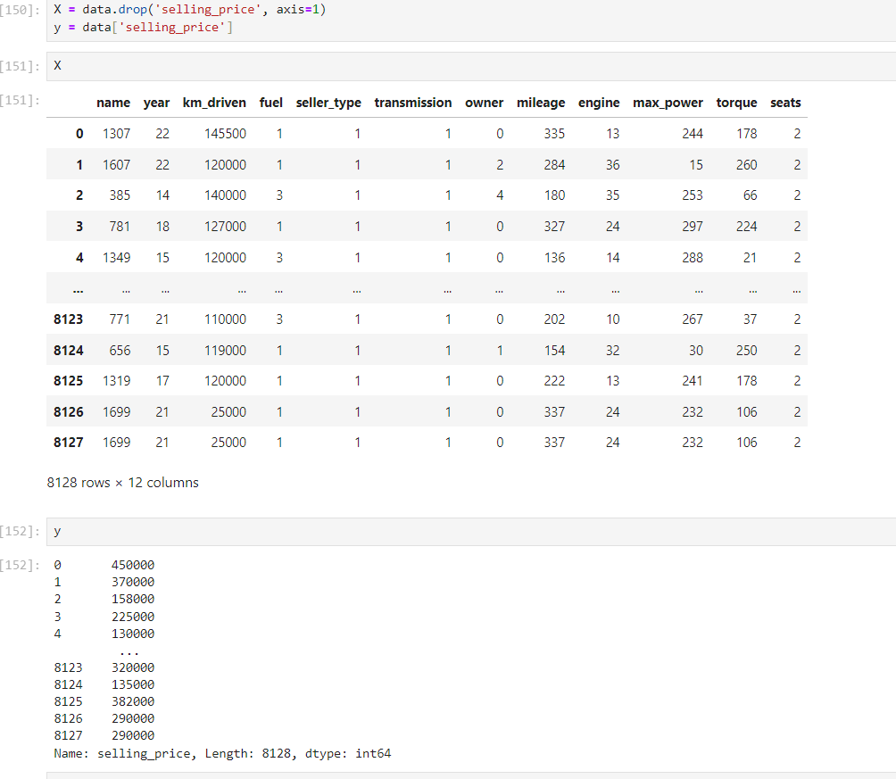
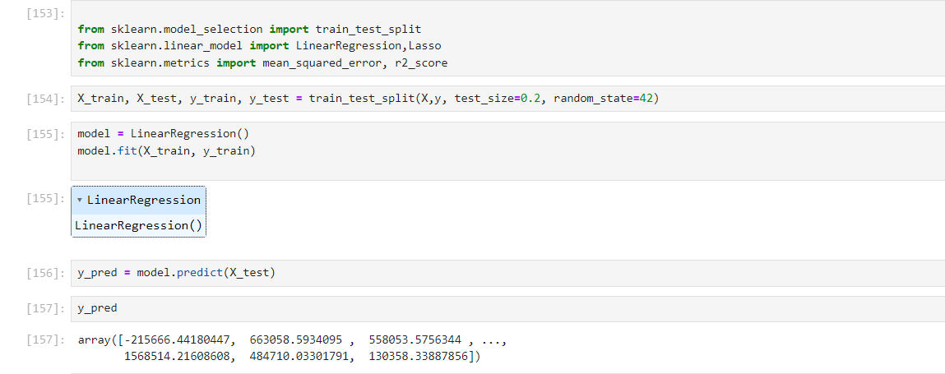

Slide 10
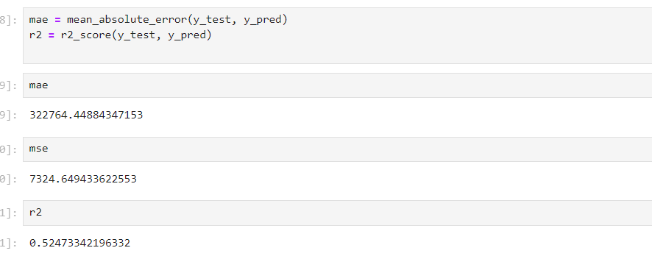
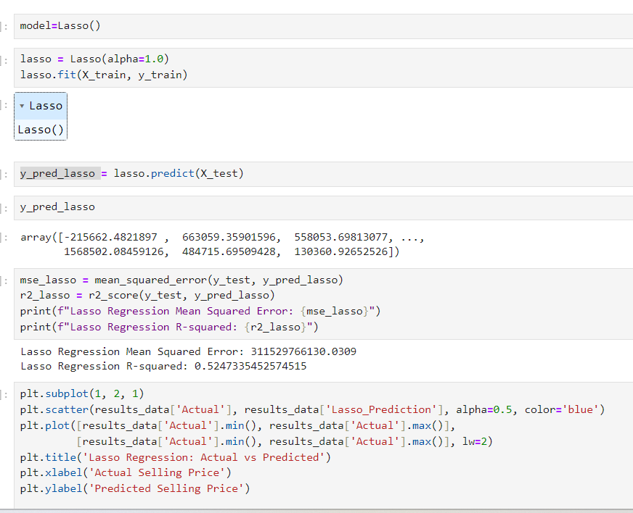
Notes:
The Mean Squared Error measures how close a regression line is to a set of data points. It is a risk function corresponding to the expected value of the squared error loss.

Slide 11
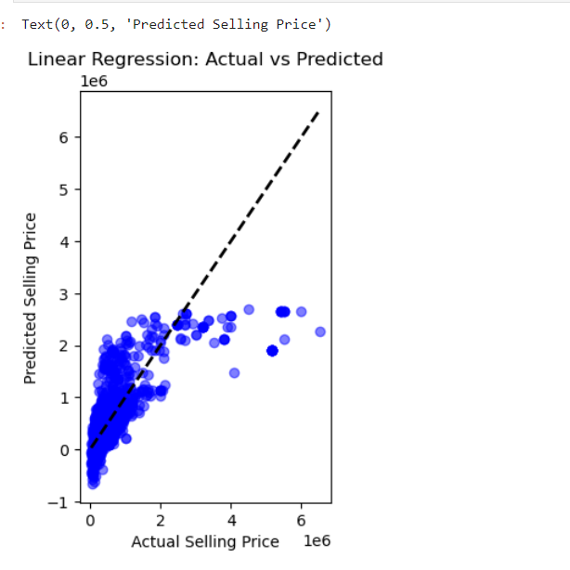

Slide 12
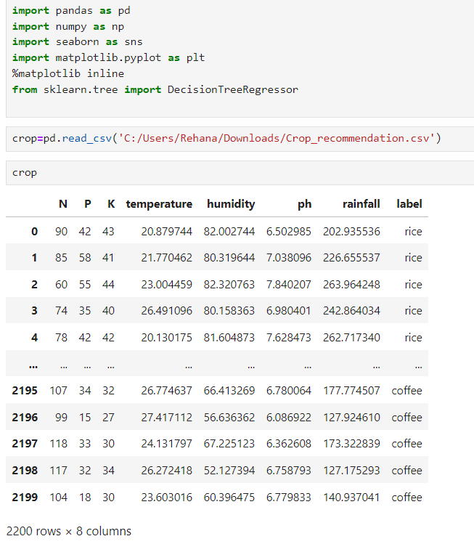
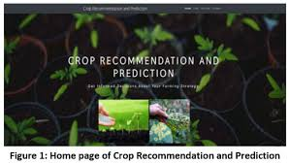

Slide 13
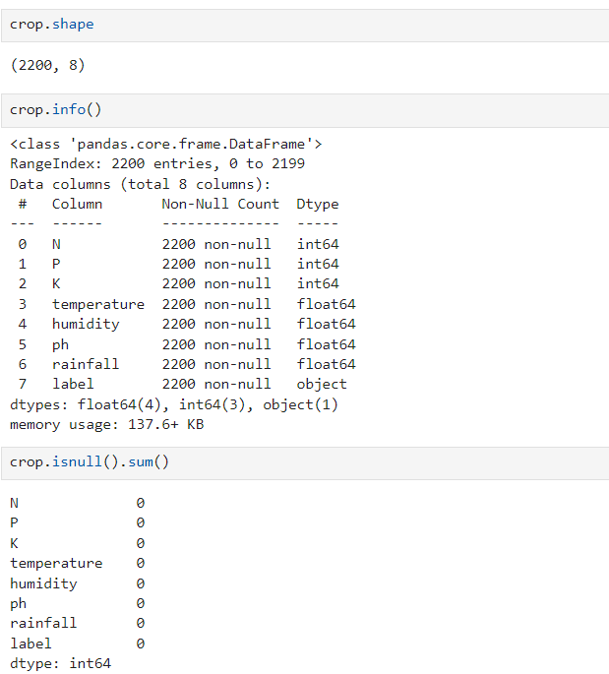
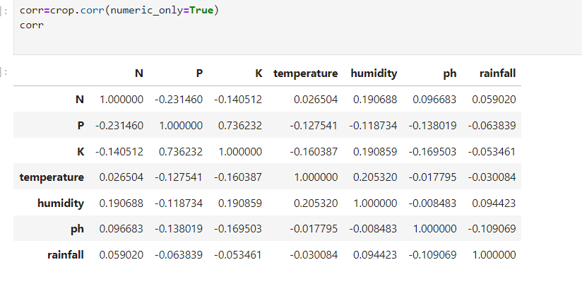

Slide 14
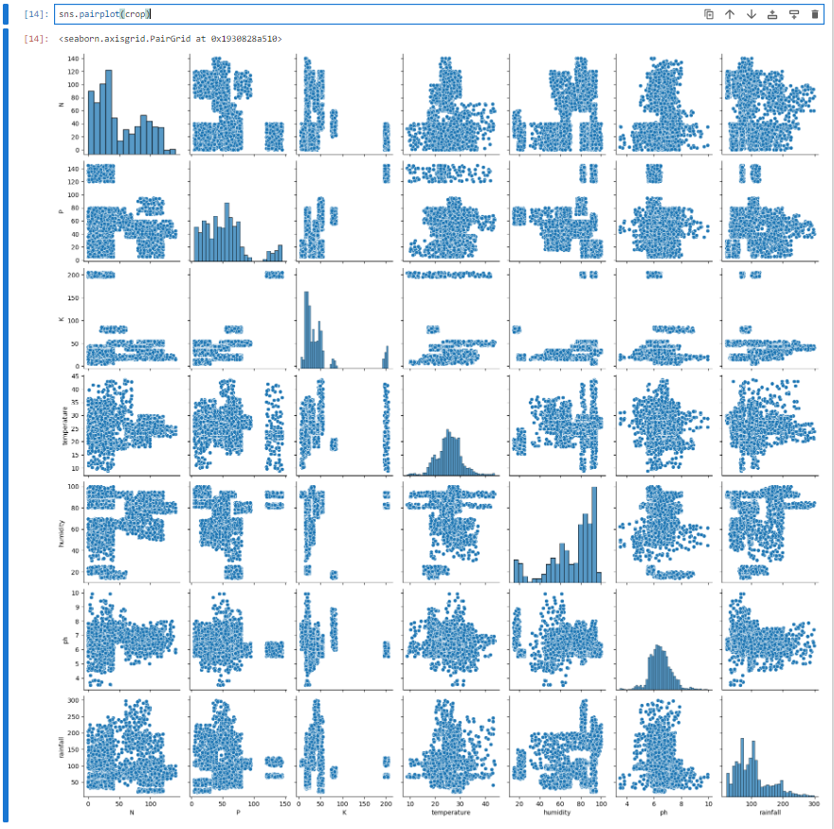
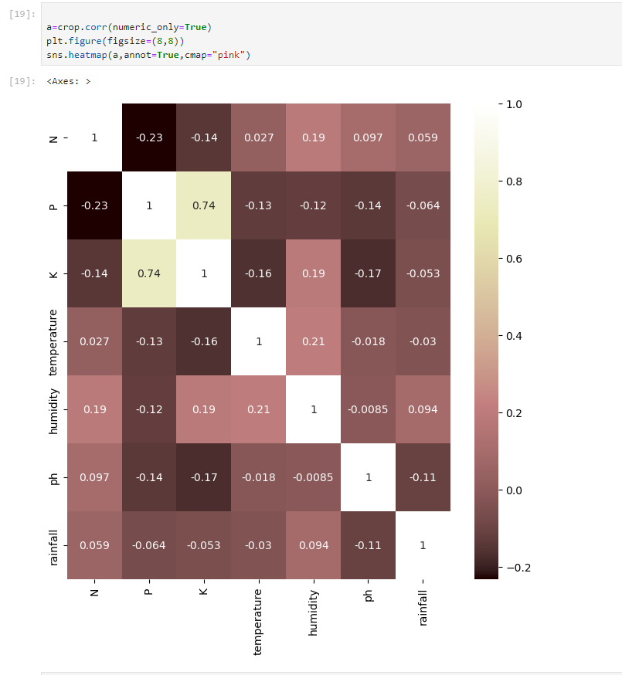

Slide 15
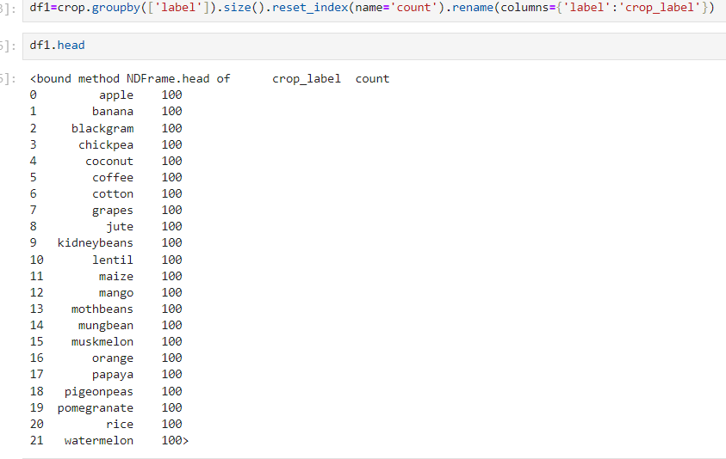
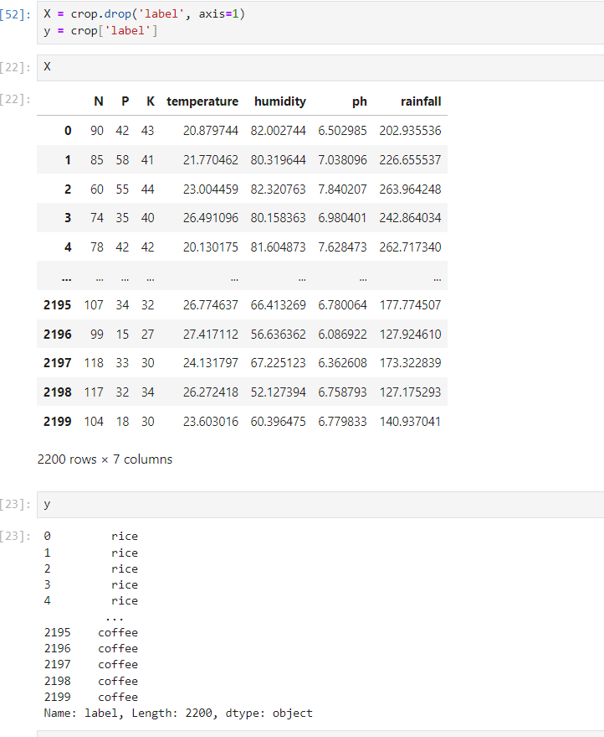

Slide 16
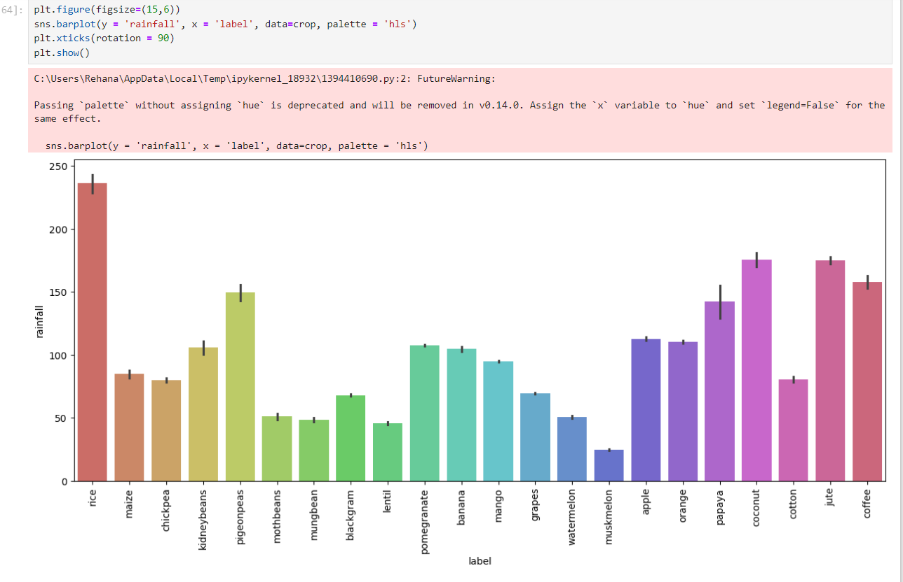

Slide 17
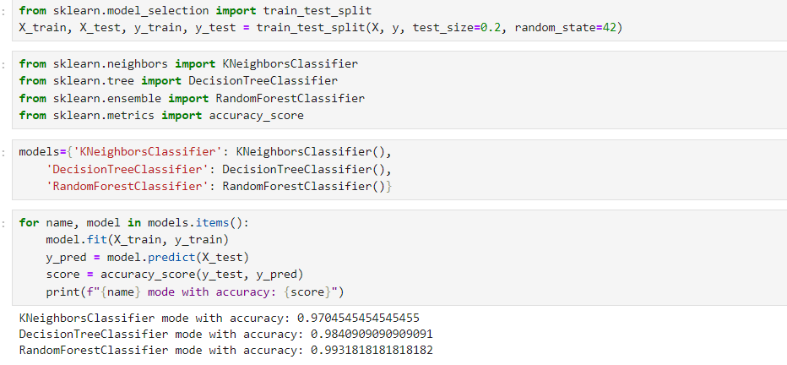
Notes:
K-NN algorithm assumes the similarity between the new case/data and available cases and put the new case into the category that is most similar to the available categories.

Slide 18
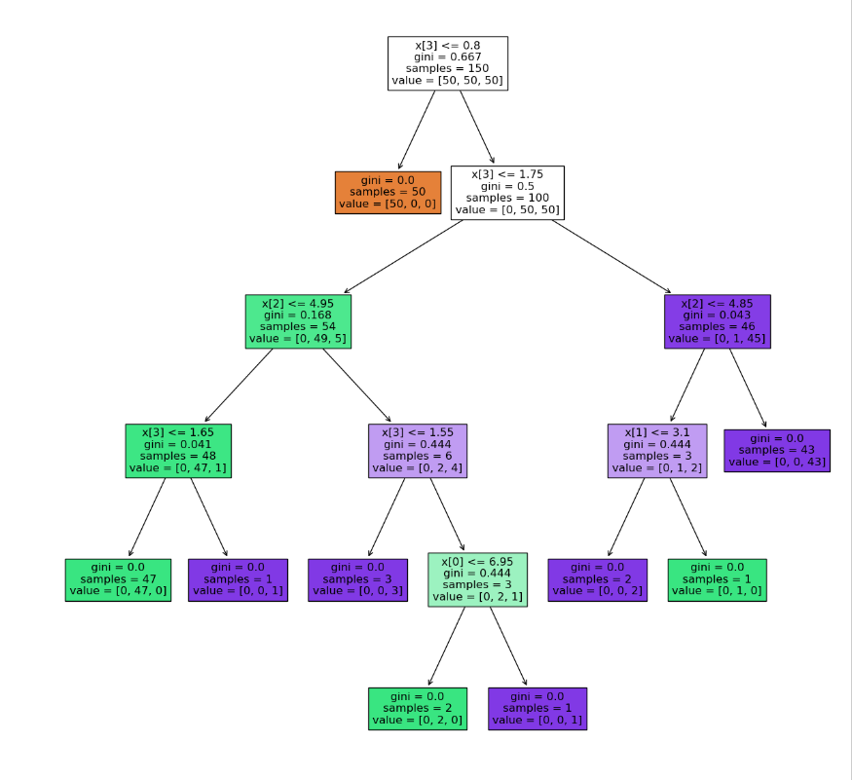

Slide 19


